Slide 1



2160707
Advanced Java
Unit-3 (Part-I)
Servlet API and Overview
Prof. Swati R. Sharma
swati.sharma@darshan.ac.in

Slide 2
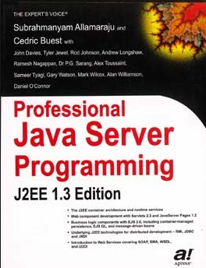
Subject Overview
Sr. No. | Unit | % Weightage
1 | Java Networking | 5
2 | JDBC Programming | 10
3 | Servlet API and Overview | 25
4 | Java Server Pages | 25
5 | Java Server Faces | 10
6 | Hibernate | 15
7 | Java Web Frameworks: Spring MVC | 10
Reference Book:
Professional Java Server Programming by Subrahmanyam Allamaraju, Cedric Buest Wiley Publication
Chapter 6,7,8
ADVANCED JAVA - 2160707 Darshan Institute of Engineering & Technology

Slide 3
What is Servlet?
“ Servlet is java class
which
extends the functionality of web server
by
dynamically generating web pages.”

Slide 4


Servlet: Basic Terms
Before looking into Servlet, we will see some important keywords about web application.
Web Client: We will call browsers (IE, Chrome, Mozilla etc.) as a Client, which helps in communicating with the server
Http Request
Server and Client (browser) will communicate with each other with the help of HTTP protocol.
Web Server is the one which takes the client request, process the request and sends back the response.
Client
Server
Http Response

Slide 5
Introduction
Servlet technology is used to create Dynamic web application
Servlet technology is robust and scalable .
Before Servlet, CGI (Common Gateway Interface) scripting language was popular as a server-side programming language, but there were many disadvantages of this technology.
Changes with respect to time
To retrive server’s current DATE and Time
News paper clippings
Online Shopping
e.g. Virtual Dressing Room
..
.

Slide 6


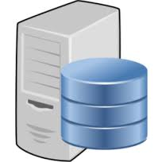


Why we need Servlet?
Nowadays everything is available on Internet.
Starting from e-banking, e-commerce everything is available through internet. We call all these applications as Web applications.
Hey Server, I want to display given name in my web page
Sorry, I can’t do that Dynamic computation
Hi, I am Servlet.
Let me help you to display given name in your web page.
But I have an application named SERVLET, which can process your request
Client
Server
Dynamic Response

Slide 7
Scripting Language

Slide 8
Scripting Language
Server-Side
Scripting Language
Client-Side
Scripting Language
PHP ASP.NET (C# OR Visual Basic) C++ Java and JSP Python Ruby on Rails etc. | JavaScript VBScript HTML (Structure) CSS (Designing) AJAX jQuery etc.
Server-side scripting is often used to provide a customized interface for the user.
Client-side scripting is an important part of the Dynamic HTML. Usually run on client’s browser.

Slide 9
CGI (Common Gateway Interface)
CGI was the 1st server-side scripting technique for creating dynamic content.
CGI is used to execute a program that resides in the server to process data or access databases to produce the relevant dynamic content.

Slide 10
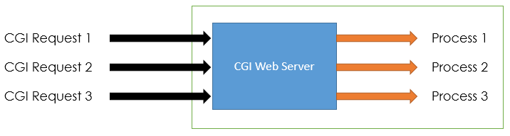
CGI (Common Gateway Interface)
For each request CGI Server receives, It creates new Operating System Process.
If the number of requests from the client increases then more time it will take to respond to the request.
As programs executed by CGI Script are written in the native languages such as C, C++, perl which are not portable.
Image Reference:http://www.c4learn.com/java/servlet/servlet-vs-cgi/

Slide 11
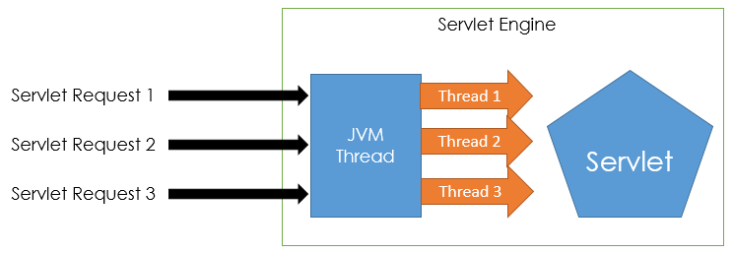
Comparing Servlet with CGI
CGI programs are used to execute programs written inside the native language.
While in Servlet, all the programs are compiled into the Java bytecode, which is then run in the Java virtual machine.
In Servlet, all the requests coming from the Client are processed with the threads instead of the OS process.
Image Reference:http://www.c4learn.com/java/servlet/servlet-vs-cgi/

Slide 12
Summary: CGI vs Servlet
CGI | Servlet
CGI was not portable. | Servlets are portable.
In CGI each request is handled by heavy weight OS process. | In Servlets each request is handled by lightweight Java Thread.
Session tracking and caching of previous computations cannot be performed. | Session tracking and caching of previous computations can be performed
CGI cannot handle cookies. | Servlets can handle cookies.
CGI does not provide sharing property. | Servlets can share data among each other.
CGI is more expensive than Servlets | Servlets is inexpensive than CGI.

Slide 13
Servlet Life Cycle

Slide 14
Servlet Life Cycle
init()
Servlet
In Service
destroy()
Servlet class is loaded.
Servlet instance is created.
init() method is invoked.
service()
Servlet Container

Slide 15
Servlet Life Cycle: init()
Servlet class is loaded
The classloader is responsible to load the servlet class. The servlet class is loaded when the first request for the servlet is received by the web container.
Servlet instance is created
The web container creates the instance of a servlet after loading the servlet class. The servlet instance is created only once in the servlet life cycle.
Init() method is invoked
The web container calls the init method only once after creating the servlet instance. The init method is used to initialize the servlet.
A Web application runs within a Web container of a Web server. Web container provides runtime environment.

Slide 16
Servlet Life Cycle: init()
Syntax:
public void init(ServletConfig config)
throws ServletException
{
//initialization…
}
A servlet configuration object used by a servlet container to pass information to a servlet during initialization process.

Slide 17
Servlet Packages
Servlet interface needs to be implemented for creating any servlet. It provides 3 life cycle methods.
Package javax.servlet
Interface
Servlet
Implemented by
It provides implementation of methods of Servlet interfaces.
GenericServlet
extended by
HttpServlet
Contains interface and abstract class for servlet that understands HTTP protocol.
Package: javax.servlet.http
Class
extended by
MyServlet
User defined Servlet class.

Slide 18
Servlet Life Cycle: Service()
The service() method is the main method to perform the actual task.
The servlet container (i.e. web server) calls the service() method to handle requests coming from the client( browsers) and to write the response back to the client.
Each time the server receives a request for a servlet, the server spawns a new thread and calls service.

Slide 19
Servlet Life Cycle: Service()
Syntax:
public void service(ServletRequest request, ServletResponse response)
throws ServletException, IOException
{
…
…
}

Slide 20
Servlet Life Cycle: Service()
The service() method checks the HTTP request type (GET, POST, PUT, DELETE, etc.) and calls doGet, doPost, doPut, doDelete, etc. methods as appropriate.
The doGet() and doPost() are most frequently used methods with in each service request.

Slide 21
Servlet Life Cycle: Destroy()
The destroy() method is called only once at the end of the life cycle of a servlet.
This method gives your servlet a chance to close
database connections,
halt background threads,
write cookie lists or hit counts to disk, and
perform other such cleanup activities.
After the destroy() method is called, the servlet object is marked for garbage collection.

Slide 22
Servlet Life Cycle: Destroy()
public void destroy()
{
// Finalization code...
}

Slide 23
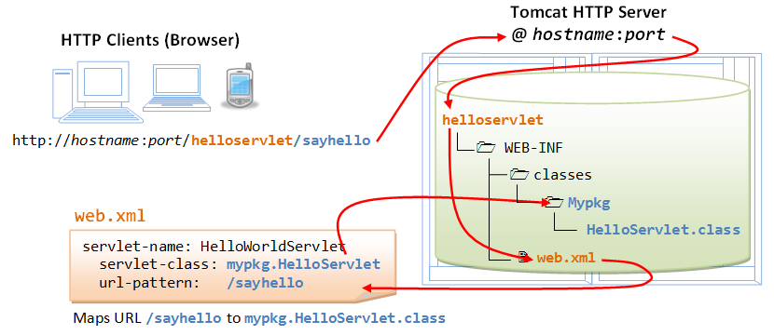
1
2
5
3
4
Ref: https://www.ntu.edu.sg/home/ehchua/programming/java/JavaServlets.html

Slide 24
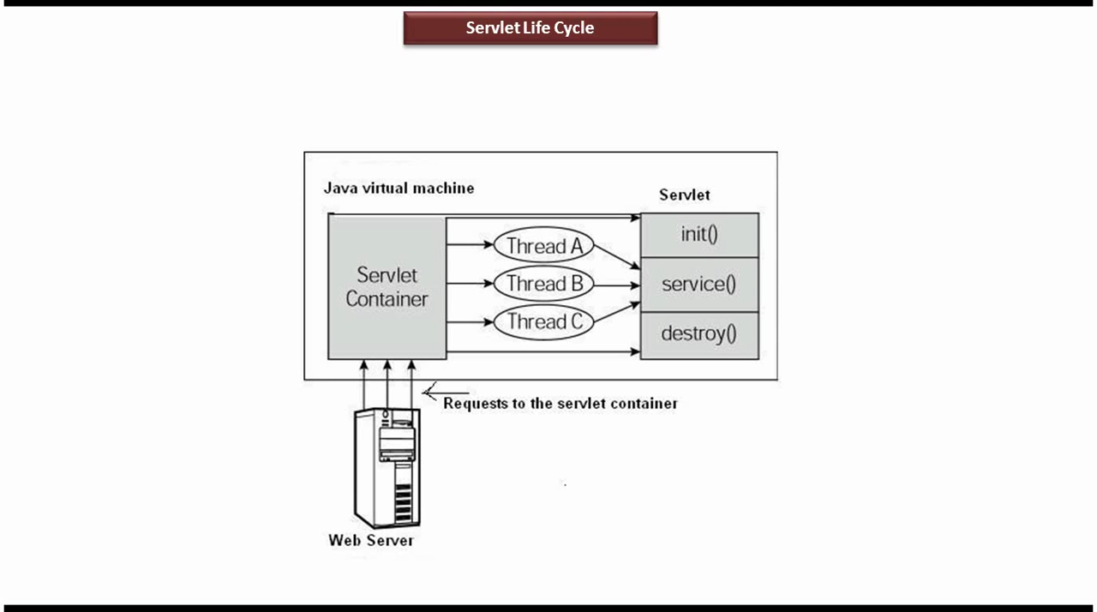
Servlet Life Cycle

Slide 25
doGet() v/s doPost()

Slide 26
doGet()
A GET request results from request for a URL or from an HTML form, should be handled by doGet() method.
Syntax:
public void doGet
(HttpServletRequest request,HttpServletResponse response)
throws ServletException, IOException
{
// Servlet code …
}

Slide 27
doPost()
A POST request results from an HTML form that specifically lists POST as the METHOD and it should be handled by doPost() method.
Syntax:
public void doPost
(HttpServletRequest request, HttpServletResponse response)
throws ServletException, IOException
{
// Servlet code …
}

Slide 28
doGet() vs doPost()
doGet() and doPost() are HTTP requests handled by servlet classes.
In doGet(), the parameters are appended to the URL and sent along with the header information.
In doPost(), the parameters are sent separately.

Slide 29
doGet() vs doPost()
Application
doGet() shall be used when small amount of data and insensitive data like a query has to be sent as a request.
doPost() shall be used when comparatively large amount of sensitive data has to be sent.
E.g.
Sending data after filling up a form or sending login & password.

Slide 30
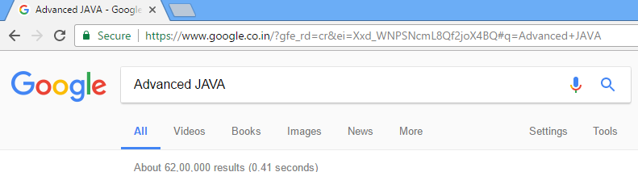
doGet() vs doPost()
Example: doGet()

Slide 31
doGet() vs doPost()
doGet() | doPost()
In this method, parameters are appended to the URL and sent along with header information | In doPost(), parameters are sent in separate line in the body
Maximum size of data that can be sent using doGet() is 240 bytes | There is no maximum size for data
Parameters are not encrypted | Parameters are encrypted here
Application: Used when small amount of insensitive data like a query has to be sent as a request. It is default method. | Application: Used when comparatively large amount of sensitive data has to be sent. E.g. submitting sign_in or login form.
doGet() is faster comparatively | doPost() is slower compared to doGet() since doPost() does not write the content length

Slide 32
GTU Questions
1. | List and Explain various stages of Servlet life cycle. Explain role of web container.[7] | Sum’16 Win’17 Win’18 Sum’19 Win’19
2. | Servlets vs CGI [3] | Sum’16

Slide 33
Servlet Life Cycle: Servlet Code
import java.io.*;
import javax.servlet.*;
public class MyServlet1 extends GenericServlet
{
public void init() throws ServletException
{//Initailization Code
}
public void service(ServletRequest request,
ServletResponse response) throws ServletException,IOException
{//Servlet code
}
public void destroy()
{//Finalization Code
}
}

Slide 34
Steps to run Servlet Program in
Using Netbeans IDE

Slide 35
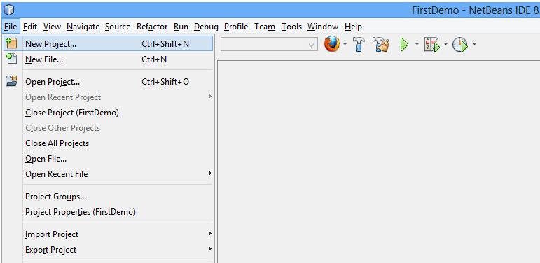
Steps to run Servlet Program
Step 1: Open Netbeans IDE, Select File -> New Project

Slide 36
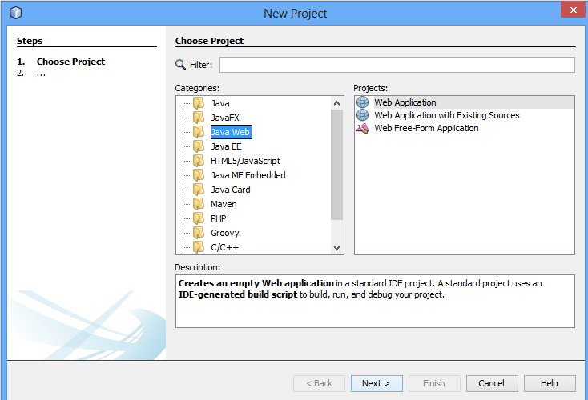
Steps for Servlet Program
Step 2: Select Java Web -> Web Application, then click on Next

Slide 37
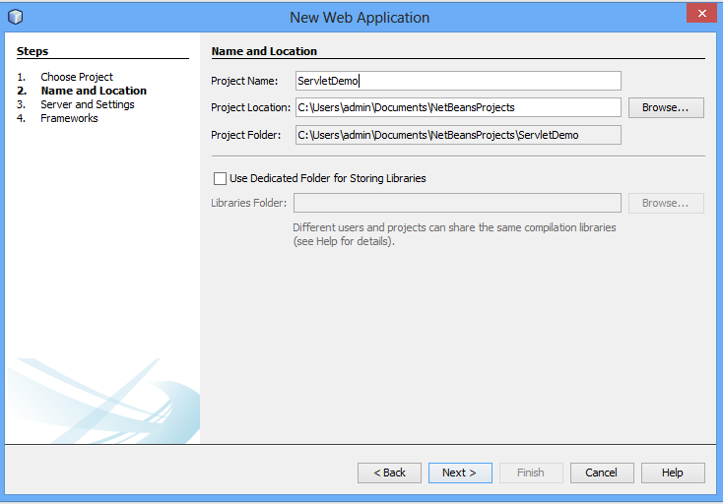
Steps for Servlet Program
Step 3: Give a name to your project and click on Next,

Slide 38
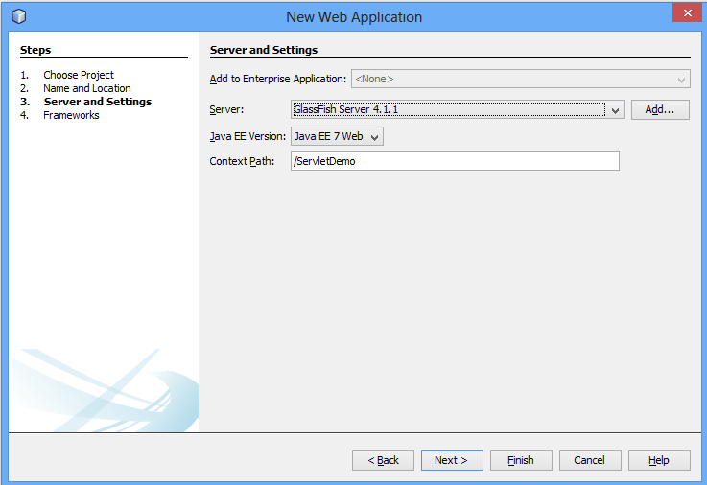
Steps for Servlet Program
Step 4: and then, Click Finish

Slide 39
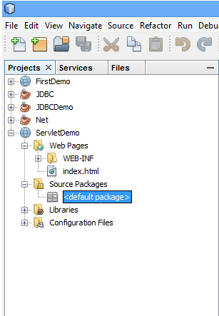
Steps for Servlet Program
Step 5: The complete directory structure required for the Servlet Application will be created automatically by the IDE.

Slide 40
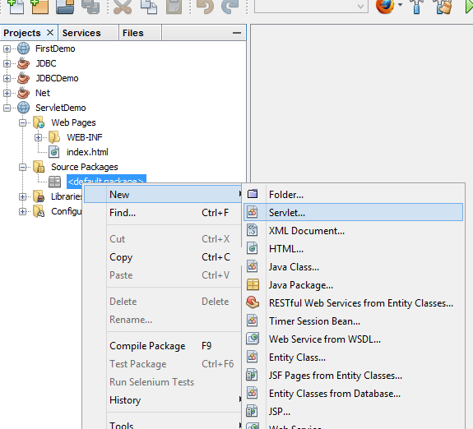
Steps for Servlet Program
Step 6: To create a Servlet, open Source Package, right click on default packages -> New -> Servlet.

Slide 41
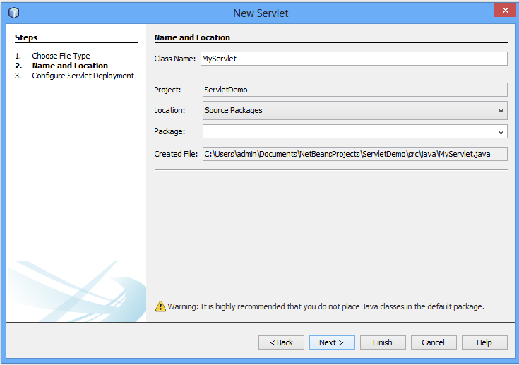
Steps for Servlet Program
Step 7: Give a Name to your Servlet class file

Slide 42
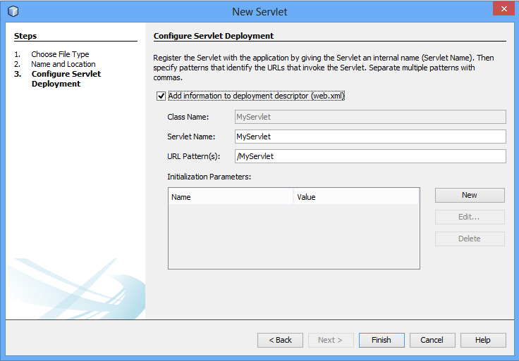
Steps for Servlet Program
Web.xml is the configuration file of web applications in java.
It will add servlet information to web.xml file

Slide 43
Step 8: Write servlet code: MyServlet.java
import java.io.*;
import javax.servlet.*;
import javax.servlet.http.*;
public class MyServlet1 extends HttpServlet
{ String msg="";
PrintWriter out;
public void init() throws ServletException
{ msg="hello world: my first servlet program"; }
public void doGet(HttpServletRequest request, HttpServletResponse response)
throws ServletException,IOException
{
response.setContentType("text/html");
out=response.getWriter();
out.println(msg);
}
public void destroy()
{ out.close();
}
}
Notes:
MIME:Multipurpose Internet Mail Extensions
A MIME type nomenclature includes a type and subtype separated by a forward slash.
It is a HTTP header that provides the description about what are you sending to the browser.
text/html
text/plain
text/css
text/richtext
application/msword
application/jar
application/pdf
images/jpeg images/png images/gif
audio/mp3
video/mp4
MIME is a standard set to Internet to notify the format of the file contents.

Slide 44
MIME: Multipurpose Internet Mail Extensions
A MIME type nomenclature includes a type and subtype separated by a forward slash.
It is a HTTP header that provides the description about what are you sending to the browser.
text/html
text/plain
text/css
text/richtext
application/msword
application/jar
application/pdf
images/jpeg images/png images/gif
audio/mp3
video/mp4
MIME is a standard set to Internet to notify the format of the file contents.

Slide 45
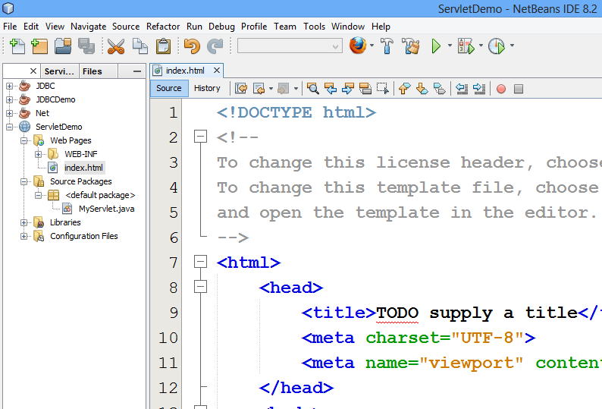
Steps for Servlet Program
Step 9: index.html

Slide 46
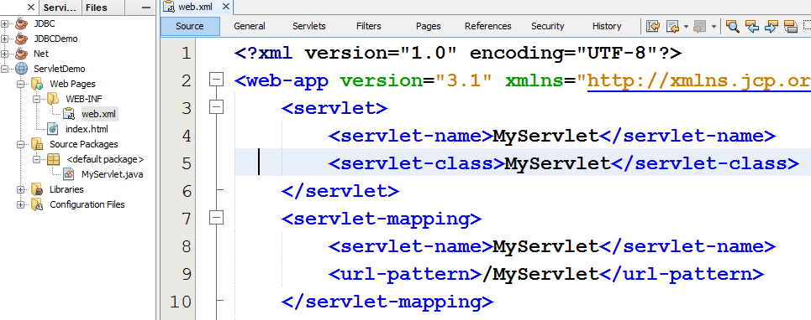
Steps for Servlet Program
Step 10: open web.xml
Configuration of servlet using <servlet>
It is used to map Servlet to specific URL
Map the servlet to a URL. This can be done using <servlet-mapping> element.

Slide 47
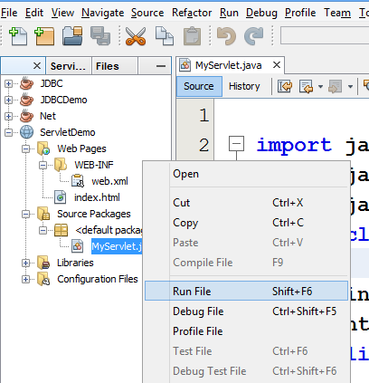
Steps for Servlet Program
Step 11: Run your application, right click on your Project and select Run

Slide 48
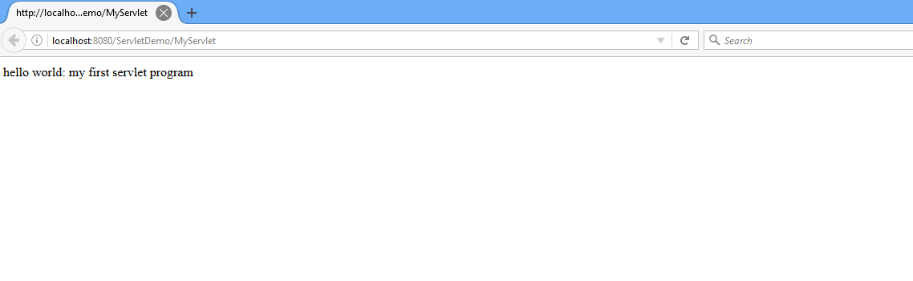
Steps for Servlet Program
Output:

Slide 49
javax.servlet Interface

Slide 50
javax.servlet Interface
It is used to get configuration information from web.xml file. If the configuration information is modified from the web.xml file, we don't need to change the servlet.
Javax.servlet
ServletConfig
ServletContext
It provides an interface between the container and servlet. It is global to entire web application
ServletRequest
It is used to provide the client request information to a servlet such as content type, content length, parameter names and values, header informations, attributes
ServletResponse
It contains various methods that enable a servlet to respond to the client requests. A servlet can send the response either as character or binary data.

Slide 51
Types of Servlet
Generic Servlet
javax.servlet (package)
extends javax.servlet.Servlet
service method
service(ServletRequest req, ServletResponse res)
Http Servlet
javax.servlet.http (package)
extends javax.servlet.HttpServlet
doGet(), doPost()
doGet(HttpServletRequest req,HttpServletResponse res)
doPost(HttpServletRequest req,HttpServletResponse res)

Slide 52
Generic Servlet: Method Summary
void init(ServletConfig config) | It is used to initialize the servlet. It is called once, automatically, by the network service each time it loads the servlet.
abstract void service (ServletRequest request, ServletResponse response) | It provides service for the incoming request. It is invoked at each time when user requests for a servlet.
void destroy() | It is invoked only once throughout the life cycle and indicates that servlet is being destroyed.
ServletConfig getServletConfig() | returns the object of ServletConfig.
ServletContext getServletContext() | returns the object of ServletContext.
String getInitParameter(String name) | returns the parameter value for the given parameter name.
Enumeration getInitParameterNames() | returns all the parameters defined in the web.xml file.
String getServletName() | returns the name of the servlet object.

Slide 53
HttpServlet: Method Summary
protected void service(HttpServletRequest req, HttpServletResponse res) | It receives the request from the service method, and dispatches the request to the doXXX() method depending on the incoming http request type.
protected void doGet(HttpServletRequest req, HttpServletResponse res) | handles the GET request. It is invoked by the web container.
protected void doPost(HttpServletRequest req, HttpServletResponse res) | handles the POST request. It is invoked by the web container.

Slide 54
GenericServlet vs HttpServlet
GenericServlet | HttpServlet
javax.servlet.GenericServlet | javax.servlet.http.HttpServlet
It defines a generic, protocol-independent servlet. | It defines a HTTP protocol specific servlet.
GenericServlet is a super class of HttpServlet class. | HttpServlet is a sub class of GenericServlet class.
Can handle all types of protocols | only HTTP specific protocols.
It supports only one abstract method:service() | It support doGet(), doPost() etc.

Slide 55
GTU Questions
1. | GenericServlet vs HttpServlet [3] | Sum’16 Win’18 Win’19

Slide 56
Deployment Descriptor
web.xml

Slide 57
Deployment Descriptor
Located @ WEB-INF directory
File known as web.xml
It controls the behavior of Java Servlet
What does it contain?
XML Header
DOCTYPE
Web-app element
The Web-app element should contain a servlet element with 3 sub-element.
<servlet-name>: name used to access java servlet
<servlet-class>: class name of java servlet
<init-param>: for initialization parameter

Slide 58
Deployment Descriptor: web.xml
<?xml version="1.0" encoding="UTF-8"?>
<!DOCTYPE web-app
PUBLIC "-//Sun Microsystems, Inc.//DTD Web Application 2.3//EN"
"http://java.sun.com/dtd/web-app_2_3.dtd">
<web-app>
<servlet>
<servlet-name>MyServlet</servlet-name>
<servlet-class>MyServlet</servlet-class>
<init-param>
<param-name>name</param-name>
<param-value>cxcy</param-value>
</init-param>
</servlet>
<servlet-mapping>
<servlet-name>MyServlet</servlet-name>
<url-pattern>/MyServlet</url-pattern>
</servlet-mapping>
</web-app>
xml header
Configures a web application.
Document Type Definition
Name used to access Java Servlet
Name of servlet .java class
Used to pass parameters to a servlet from the web.xml file.
map the servlet to a URL or URL pattern
Controls behavior of Servlet

Slide 59
Program to call servlet from html file

Slide 60
Servlet Program
Write a java Servlet program to call servlet from html hyperlink.
2.html
<html>
<head>
<title> HyperLinkDemo </title>
</head>
<body>
<a href = "/ServletDemo2/HyperLinkDemo">HyperLinkDemo.java </a>
</body>
</html>

Slide 61
Servlet Program: HyperLinkDemo.java
import javax.servlet.*;
import javax.servlet.http.*;
import java.io.*;
public class HyperLinkDemo extends HttpServlet
{ String msg="";
PrintWriter out;
public void init(ServletConfig config)throws ServletException
{ msg="hello world! MY first Servlet Program...";
}
public void doGet(HttpServletRequest request,HttpServletResponse response) throws ServletException,IOException
{ response.setContentType("text/html");
out=response.getWriter();
out.println("<h1>"+msg+"</h1>");
}
public void destroy()
{ out.close();
}}

Slide 62
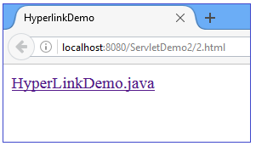
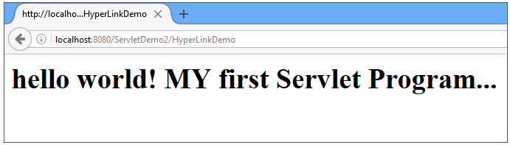
Servlet Program: Output

Slide 63
doGet()

Slide 64
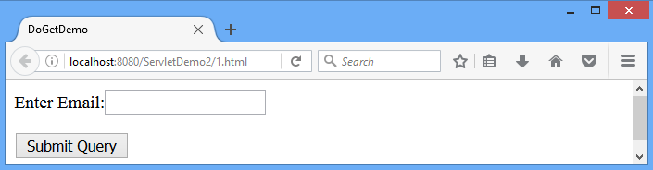
HttpServlet : 1.html
<html>
<head>
<title> DoGetDemo </title>
</head>
<body>
<form action="/ServletDemo2/DoGetDemo">
Enter Email:<input type="text" name="email">
<p><input type="submit"></p>
</form>
</body>
</html>

Slide 65
HttpServlet: DoGetDemo.java
import javax.servlet.*;
import javax.servlet.http.*;
import java.io.*;
public class DoGetDemo extends HttpServlet
{ PrintWriter out;
public void init(ServletConfig config)throws ServletException
{ }
public void doGet(HttpServletRequest request,HttpServletResponse response)
throws ServletException,IOException
{
String email=request.getParameter("email");
response.setContentType("text/html");
out =response.getWriter();
out.println("my email:"+email);
}
public void destroy()
{ out.close(); }
}
String getParameter(String name)
Returns the value of a request parameter as a String

Slide 66
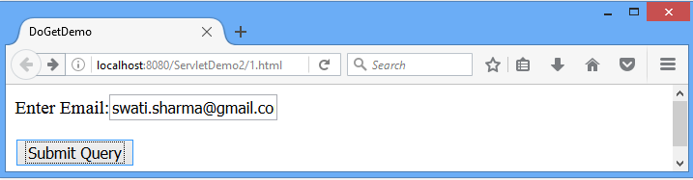
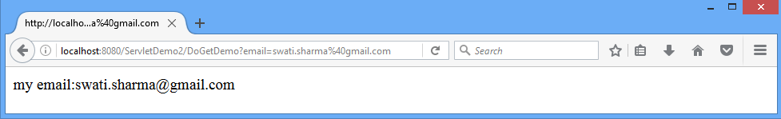
Output

Slide 67
doPost()
Write a Servlet program to enter two numbers and find maximum among them.

Slide 68
Servlet program: doPost()
.html
.java
[Servlet]

Slide 69
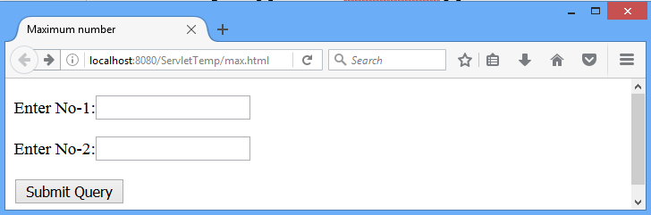
Servlet program using doPost()
max.html
<!DOCTYPE html>
<html>
<head>
<title> Maximum number </title>
</head>
<body>
<form action="/ServletTemp/Max" method="POST" >
<p>Enter No-1:<input type="text" name="no1"></p>
<p>Enter No-2:<input type="text" name="no2"></p>
<p><input type="submit"></p>
</form>
</body>
</html>

Slide 70
Servlet program using doPost()
import java.io.*;
import javax.servlet.*;
import javax.servlet.http.*;
public class Max extends HttpServlet
{ public void doPost(HttpServletRequest request, HttpServletResponse response)throws ServletException,IOException
{ int n1=0,n2=0;
response.setContentType("text/html");
PrintWriter out=response.getWriter();
n1=Integer.parseInt(request.getParameter("no1"));
n2=Integer.parseInt(request.getParameter("no2"));
if(n1>n2)
out.println("n1="+n1+"is max number");
else if(n2>n1)
out.println("n2="+n2+"is max number");
else if(n1==n2)
out.println("n1= "+n1+"and n2= "+n2+"are equal numbers");
}
}

Slide 71

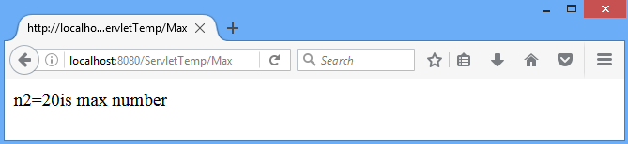
Servlet program using doPost()
Executing max.html
Using doPost()

Slide 72
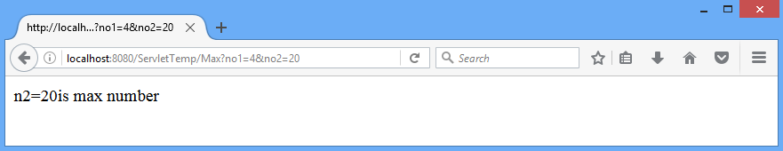
Servlet program using doGet()
Using doGet()

Slide 73
ServletConfig Interface

Slide 74
Servlet Config
It is used to get configuration information from web.xml file.
If the configuration information is modified from the web.xml file, we don't need to change the servlet.
Method
Example
String str = config.getInitParameter("name")
String getInitParameter(String name) | Returns the parameter value for the specified parameter name.
web.xml
<init-param>
<param-name>name</param-name>

Slide 75
Servlet Config: web.xml
<web-app>
<servlet>
<servlet-name>MyServlet</servlet-name>
<servlet-class>MyServlet</servlet-class>
<init-param>
<param-name>name</param-name>
<param-value>cxcy</param-value>
</init-param>
</servlet>
<servlet-mapping>
<servlet-name>MyServlet</servlet-name>
<url-pattern>/MyServlet</url-pattern>
</servlet-mapping>
</web-app>

Slide 76
Servlet Config: MyServlet.java
import javax.servlet.*;
import javax.servlet.http.*;
import java.io.*;
public class MyServlet extends HttpServlet
{ String msg;
PrintWriter out;
public void init(ServletConfig config)throws ServletException
{ msg = config.getInitParameter("name"); }
public void doGet(HttpServletRequest request , HttpServletResponse response) throws
ServletException,IOException
{ response.setContentType("text/html");
out = response.getWriter();
out.println("<h1>"+ msg +"</h1>");
}
public void destroy()
{ out.close(); }}

Slide 77
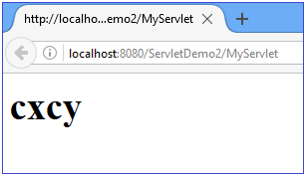
Servlet Config: Output
<param-value>

Slide 78
ServletContext Interface

Slide 79
ServletContext Interface
ServletContext is created by the web container at time of deploying the project.
It can be used to get configuration information from web.xml file.
There is only one ServletContext object per web application.
If any information is shared to many servlet, it is better to provide it from the web.xml file using the <context-param> element.

Slide 80
Context Parameter Initialized inside web.xml
<web-app>
...
<context-param>
<param-name>parametername</param-name>
<param-value>parametervalue</param-value>
</context-param>
...
<servlet>
...
</servlet>
</web-app>
used to define initialization parameter in the application scope.

Slide 81
web.xml
<?xml version="1.0" encoding="UTF-8"?>
<web-app>
<servlet>
<servlet-name>ServletContextDemo</servlet-name>
<servlet-class>ServletContextDemo</servlet-class>
</servlet>
<servlet-mapping>
<servlet-name>ServletContextDemo</servlet-name>
<url-pattern>/ServletContextDemo</url-pattern>
</servlet-mapping>
<context-param>
<param-name>name</param-name>
<param-value>DIET</param-value>
</context-param>
</web-app>

Slide 82
ServletContextDemo.java
import java.io.*;
import javax.servlet.*;
import javax.servlet.http.*;
public class ServletContextDemo extends HttpServlet{
public void doGet(HttpServletRequest req,HttpServletResponse res) throws ServletException,IOException
{ res.setContentType("text/html");
PrintWriter out=res.getWriter();
//creating ServletContext object
ServletContext context=getServletContext();
//Getting the value of the initialization parameter and printing it
String college=context.getInitParameter("name");
out.println("College name is="+college);
out.close();
}}

Slide 83
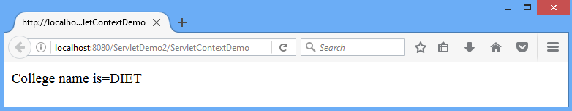
Output

Slide 84
Servlet Config vs Servlet Context
Servlet Config | Servlet Context
ServletConfig object is one per servlet class | ServletContext object is global to entire web application
Object of ServletConfig will be created during initialization process of the servlet | Object of ServletContext will be created at the time of web application deployment
Scope: As long as a servlet is executing, ServletConfig object will be available, it will be destroyed once the servlet execution is completed. | Scope: As long as web application is executing, ServletContext object will be available, and it will be destroyed once the application is removed from the server.
We should give request explicitly, in order to create ServletConfig object for the first time | ServletContext object will be available even before giving the first request
In web.xml – <init-param> tag will be appear under <servlet-class> tag | In web.xml – <context-param> tag will be appear under <web-app> tag

Slide 85
Servlet Program
Write a java program to accept one String from ServletConfig object and another from ServletContext object and Concat both the String. Display the String and String Length.

Slide 86
HttpServletRequest
Methods

Slide 87
HttpServletRequest: Methods
String getContextPath() | Returns the portion of the request URI that indicates the context of the request.
Enumeration getHeaderNames() | Returns an enumeration of all the header names this request contains.
String getHeader(String name) | Returns the value of the specified request header as a String.
String getQueryString() | Returns the query string that is contained in the request URL after the path.
String getServletPath() | Returns the part of this request's URL that calls the servlet. This path starts with a "/" character and includes either the servlet name or a path to the servlet
String getMethod() | Returns the name of the HTTP method with which this request was made, for example GET or POST

Slide 88
HttpServletRequest: Methods
String getContextPath() | Returns the portion of the request URI that indicates the context of the request.
Example
public void doGet(HttpServletRequest request, HttpServletResponse response)
{
out.println("<p>request.getContextPath():" +request.getContextPath()+"</p>");
}
Output
request.getContextPath():/ServletTemp

Slide 89
HttpServletRequest: Methods
Enumeration getHeaderNames() | Returns an enumeration of all the header names this request contains.
Example
public void doGet(HttpServletRequest request, HttpServletResponse response)
{
Enumeration h=request.getHeaderNames();
while(h.hasMoreElements())
{
String paramName = (String)h.nextElement();
out.print("<p>" + paramName + "\t");
String paramValue = request.getHeader(paramName);
out.println( paramValue + "</p>\n");
}
}

Slide 90
Output
host localhost:8080
user-agent Mozilla/5.0 (Windows NT 6.2; WOW64; rv:50.0) Gecko/20100101 Firefox/50.0
accept text/html,application/xhtml+xml, application/xml;q=0.9,*/*;q=0.8
accept-language en-US,en;q=0.5
accept-encoding gzip, deflate
connection keep-alive
upgrade-insecure-requests 1

Slide 91
HttpServletRequest: Methods
String getHeader(String name) | Returns the value of the specified request header as a String.
Example
public void doGet(HttpServletRequest request, HttpServletResponse response)
{
out.println("<p>request.getHeader(): " +request.getHeader("host")+"</p>");
out.println("<p>request.getHeader(): " +request.getHeader("referer")+"</p>");
}
Output
request.getHeader():host=localhost:8080
request.getHeader():referer=http://localhost:8080
/ServletTemp/servletmeth.html

Slide 92
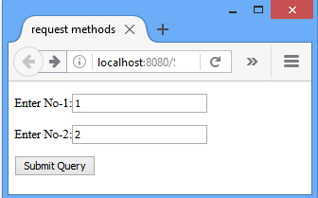
HttpServletRequest: Methods
String getQueryString() | Returns the query string that is contained in the request URL after the path.
Example
public void doGet(HttpServletRequest request, HttpServletResponse response)
{
out.println("<p>request.getQueryString():" +request.getQueryString()+"</p>");
}
Output
request.getQueryString(): no1=1&no2=2

Slide 93
HttpServletRequest: Methods
String getServletPath() | Returns the part of this request's URL that calls the servlet. This path starts with a "/" character and includes either the servlet name or a path to the servlet
Example
public void doGet(HttpServletRequest request, HttpServletResponse response)
{
out.println("<p>request.getServletPath():" +request.getServletPath()+"</p>");
}
Output
request.getServletPath(): /ServletMeth

Slide 94
HttpServletRequest: Methods
String getMethod() | Returns the name of the HTTP method with which this request was made, for example GET or POST
Example
public void doGet(HttpServletRequest request, HttpServletResponse response)
{
out.println("<p>request.getMethod():" +request.getMethod()+"</p>");
}
Output
request.getMethod(): GET

Slide 95
Servlet Collaboration
RequestDispatcher Interface

Slide 96
javax.servlet.RequestDispatcher Interface
The RequestDispatcher interface provides the facility of dispatching the request to another resource.
Resource can be HTML, Servlet or JSP.
This interface can also be used to include the content of another resource.
It is one of the way of servlet collaboration.

Slide 97
RequestDispatcher :Method
void forward(ServletRequest request, ServletResponse response) throws ServletException, IOException | Forwards a request from a servlet to another resource (servlet, JSP file, or HTML file) on the server.
void include(ServletRequest request, ServletResponse response) throws ServletException, IOException | Includes the content of a resource (Servlet, JSP page, or HTML file) in the response.

Slide 98

RequestDispatcher: forward()
Step2: forward(req, res)
Servlet 1
Servlet 2
Step1: Request
Step 3:
Response is generated
Response
Web Client
Step 4: Response is sent back to browser
Response

Slide 99
RequestDispatcher: include()
Step2: include(req, res)
Servlet 1
Servlet 2
Step1: Request
Step3:
Response of Servlet 2 is included in the Response of Servlet 1
Response
Web Client
Response
Final Response is sent back to the client fron Servlet 1

Slide 100
How to get the object of RequestDispatcher?
The getRequestDispatcher() method of ServletRequest interface returns the object of RequestDispatcher.
Syntax
RequestDispatcher getRequestDispatcher(String resource)
Example RequestDispatcher rd=request.getRequestDispatcher("servlet2");rd.forward(request, response);//method may be include/forward
Name of Servlet specified in <url-pattern>

Slide 101
RequestDispatcher: forward()
Example: forward()
RequestDispatcher rd = request.getRequestDispatcher("servlet2");
rd.forward(request, response);
RequestDispatcher rd = request.getRequestDispatcher("/1.html");
rd.forward(request, response);

Slide 102
RequestDispatcher: include()
Example: include()
RequestDispatcher rd= request.getRequestDispatcher("servlet2");
rd.include(request, response);
RequestDispatcher rd= request.getRequestDispatcher("/1.html");
rd.include(request, response);

Slide 103
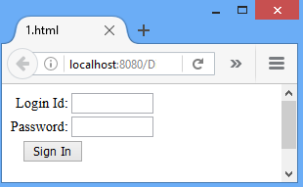
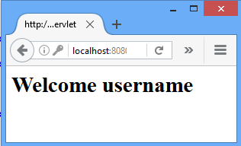
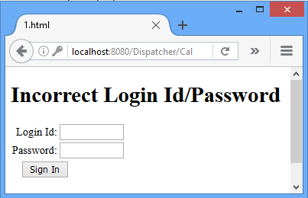
RequestDispatcher: Servlet Program
Validate Servlet
[CallServlet.java]
IsValid?
Yes
No
[include: 1.html]
[forward: FwdDemo.java]

Slide 104
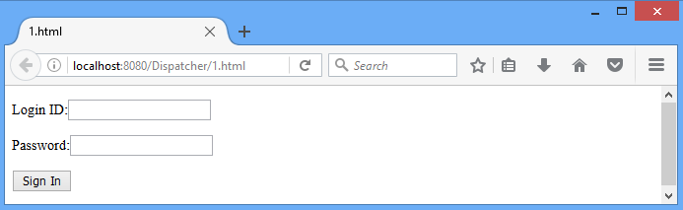
RequestDispatcher: 1.html
<html>
<head>
<title>1.html</title>
</head>
<body>
<form action="/Dispatcher/CallServlet" method="POST">
<p>Login ID:<input type="text" name="login"></p>
<p>Password:<input type="text" name="pwd"></p>
<p><input type="submit" value="Sign In"></p>
</form>
</body>
</html>

Slide 105
RequestDispatcher: Validate Servlet
public class CallServlet extends HttpServlet
{ public void doPost(HttpServletRequest request, HttpServletResponse response)
throws ServletException,IOException
{ response.setContentType("text/html");
PrintWriter out=response.getWriter();
RequestDispatcher rd;
String login=request.getParameter("login");
String pwd=request.getParameter("pwd");
if(login.equals("java") && pwd.equals("servlet"))
{ rd=request.getRequestDispatcher("FwdDemo");
rd.forward(request, response);}//if
else
{ out.println("<p><h1>Incorrect Login Id/Password </h1></p>");
rd=request.getRequestDispatcher("/1.html");
rd.include(request, response); }//else }//dopost }

Slide 106
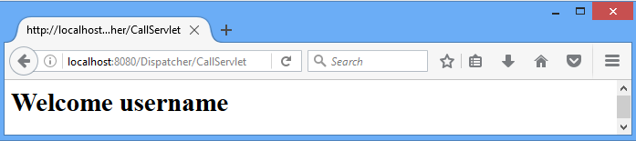
RequestDispatcher: fwdDemo.java
import javax.servlet.*;
import javax.servlet.http.*;
import java.io.*;
public class FwdDemo extends HttpServlet{
public void doPost(HttpServletRequest request, HttpServletResponse response)
throws ServletException,IOException
{ response.setContentType("text/html");
PrintWriter out=response.getWriter();
String username=request.getParameter("login");
out.println("<h1>"+"Welcome "+username+"</h1>");
}
}

Slide 107
RequestDispatcher: web.xml
<web-app>
<servlet>
<servlet-name>FwdDemo</servlet-name>
<servlet-class>disp.FwdDemo</servlet-class>
</servlet>
<servlet>
<servlet-name>CallServlet</servlet-name>
<servlet-class>disp.CallServlet</servlet-class>
</servlet>
<servlet-mapping>
<servlet-name>FwdDemo</servlet-name>
<url-pattern>/FwdDemo</url-pattern>
</servlet-mapping>
<servlet-mapping>
<servlet-name>CallServlet</servlet-name>
<url-pattern>/CallServlet</url-pattern>
</servlet-mapping>
</web-app>

Slide 108
Servlet Collaboration
sendRedirect()
javax.servlet.http.HttpServletResponse

Slide 109
SendRedirect
The sendRedirect() method of HttpServletResponse interface can be used to redirect response to another resource, it may be servlet, jsp or html file.
Syntax
void sendRedirect(String location)
throws IOException
Example
response.sendRedirect("http://www.darshan.ac.in");
response.sendRedirect("/1.html");//relative path
response.sendRedirect("http://localhost:8080/1.html");
//absolute path

Slide 110
sendRedirect(): Example
public class Redirect extends HttpServlet
{ public void doGet( HttpServletRequest request, HttpServletResponse response)
throws ServletException,IOException
{ response.setContentType("text/html");
PrintWriter out=response.getWriter();
String login=request.getParameter("login");
String pwd=request.getParameter("pwd");
if(login.equals("java") && pwd.equals("servlet"))
{ response.sendRedirect("/Dispatcher/Welcome");
}
else
response.sendRedirect("/Dispatcher/redirect.html");
} //doGet
}

Slide 111
GTU Questions
Differentiate the following
forward() vs include() method of RequestDispatcher
forward() vs sendRedirect()

